Slide 1

Developing Gross Motor Skill Tips
Movement in Small Spaces
Use the furniture for safe games.
Use safe equipment for the size of the space (soft balls, balloons, woggles for striking).
Inside and outside can both be used for a variety of activities.
Move furniture out of the way to increase space for activities.
Use trips to the park and beach to develop skills in larger spaces.
Use adult led activities sometimes to expose the children to different skills.

Slide 2
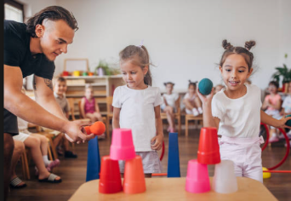
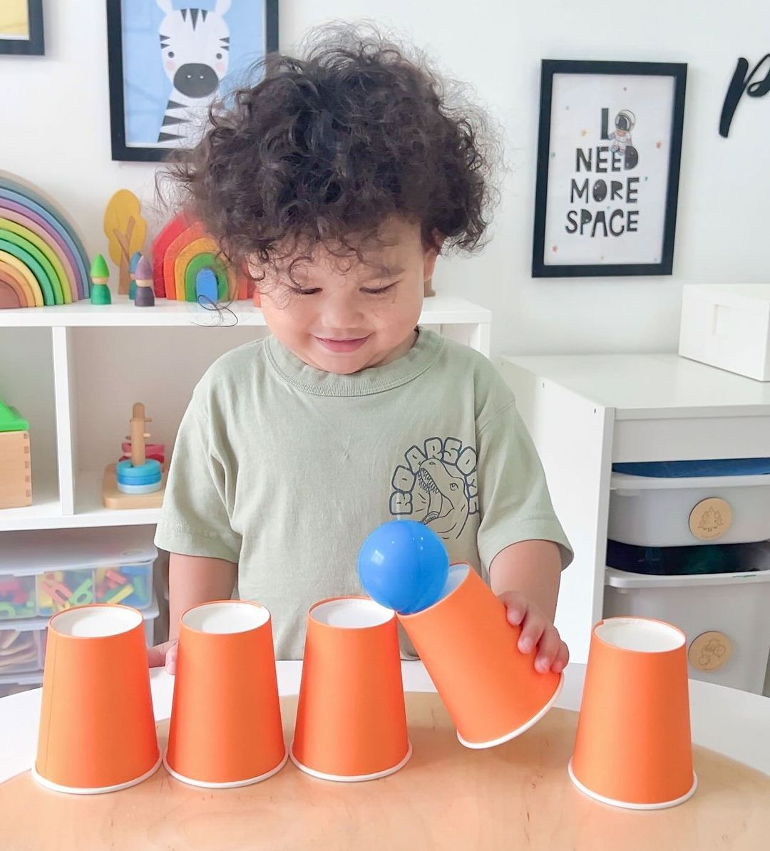
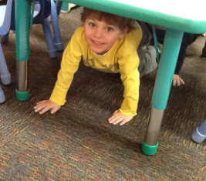
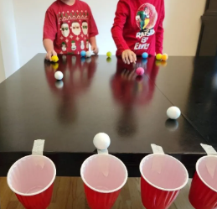
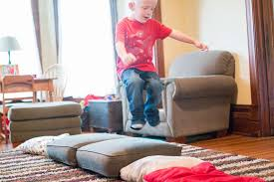
Movement in Small Spaces
Use furniture for safe games

Slide 3
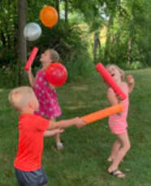
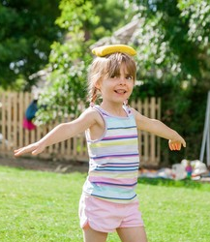
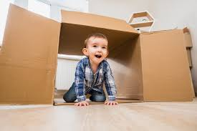
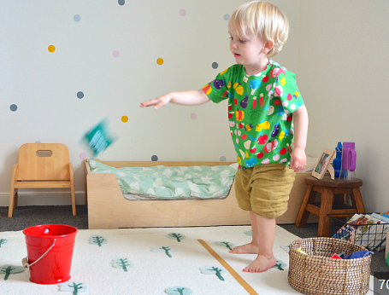
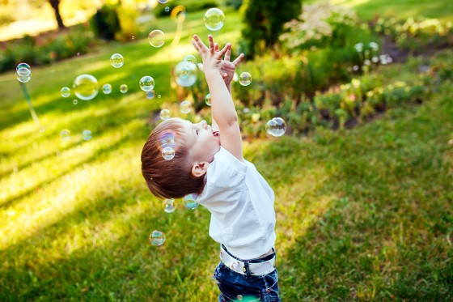
Movement in Small Spaces
Use safe equipment for the size of the space

Slide 4
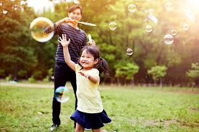
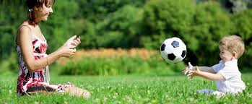
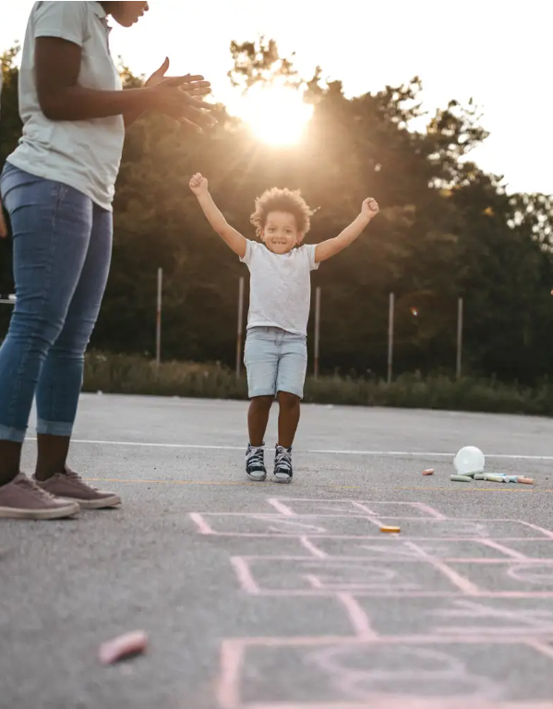
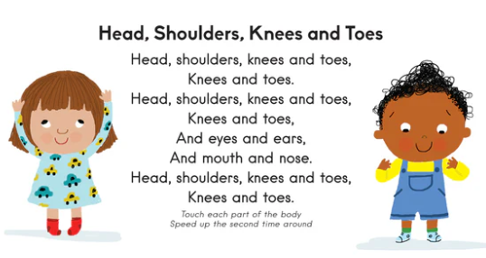
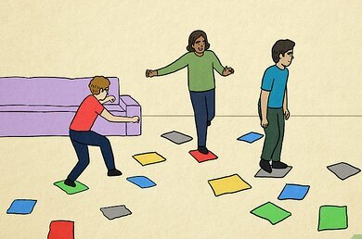
Movement in Small Spaces
Use adult led games sometimes too

